Slide 1
Ontario Gateway Case Study
Sai Sreekar, Mridul Arora, Lamiah Joint, Jeremy Edwards

Slide 2
Fiscal Analysis for Impending Change in Insurance Provider
Due to our company’s risk management strategies preceding following the merger of Ontario Airlines and Air Prix, we have reconsidered our companies risk aversion to service our debt obligations.

Slide 3
Current Policies Impending End
Current policies in place by model:
Airbus A340 ending coverage carried over from Air Prix by Lloyd’s of London, the cost of this policy is sub-optimal and we will not be looking to renew.
Boeing 757 currently maintains coverage issued under the Reinsurance Corporation of Northern California (RCNC).

Slide 4
Risk Management And Aversion
Our extensive risk management in the years preceding our merger have afforded us the following:
We will not be able to issue any further debt due to our pre-existing loan agreements.
We have minimized the Exchange Rate Risk associated with a trans-atlantic merger
We have minimized the Political Risk of government interference
We have handled our Accident risk through two different insurance policies whose renewal terms are approaching

Slide 5
Understanding Constraints
While we have had our Chief Operating Officer obtain bids from multiple insurance companies, we need to consider the financial constraints from which we must operate within while deciding which policy to proceed with. The constraints of our organization are as follows:
Remain thoroughly covered for an loss of aircraft
Take no risk with unanticipated negative cash-flow due to our highly leveraged capital structure
Incur no more than $37 million in liability over the next fiscal year to remain within a 10% safety margin of our maximum manageable losses

Slide 6
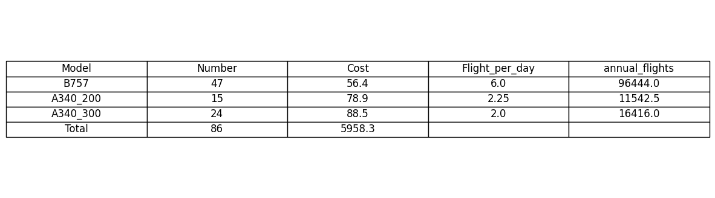
Ontario Gateway, Current Fleet Standing
Our current fleet and information regarding the per aircraft replacement cost, expressed in millions of USD ($) and per plane flights per day are as follows:

Slide 7
Testing Procedures
Testing for potential losses faces some issues, specifically in the low accident rate leading to minimal observations. Current data shows a one in five million chance of an aircraft accident for any given flight, along with an expected yearly value in incidental damage for our firm specifically being in the range of $1 million to $5 million.
To account for these low observations, we will be utilizing simulation testing to find an approximate probability of airplane incidents to calculate our potential loss and liability for the upcoming year, and the 4 years following.

Slide 8
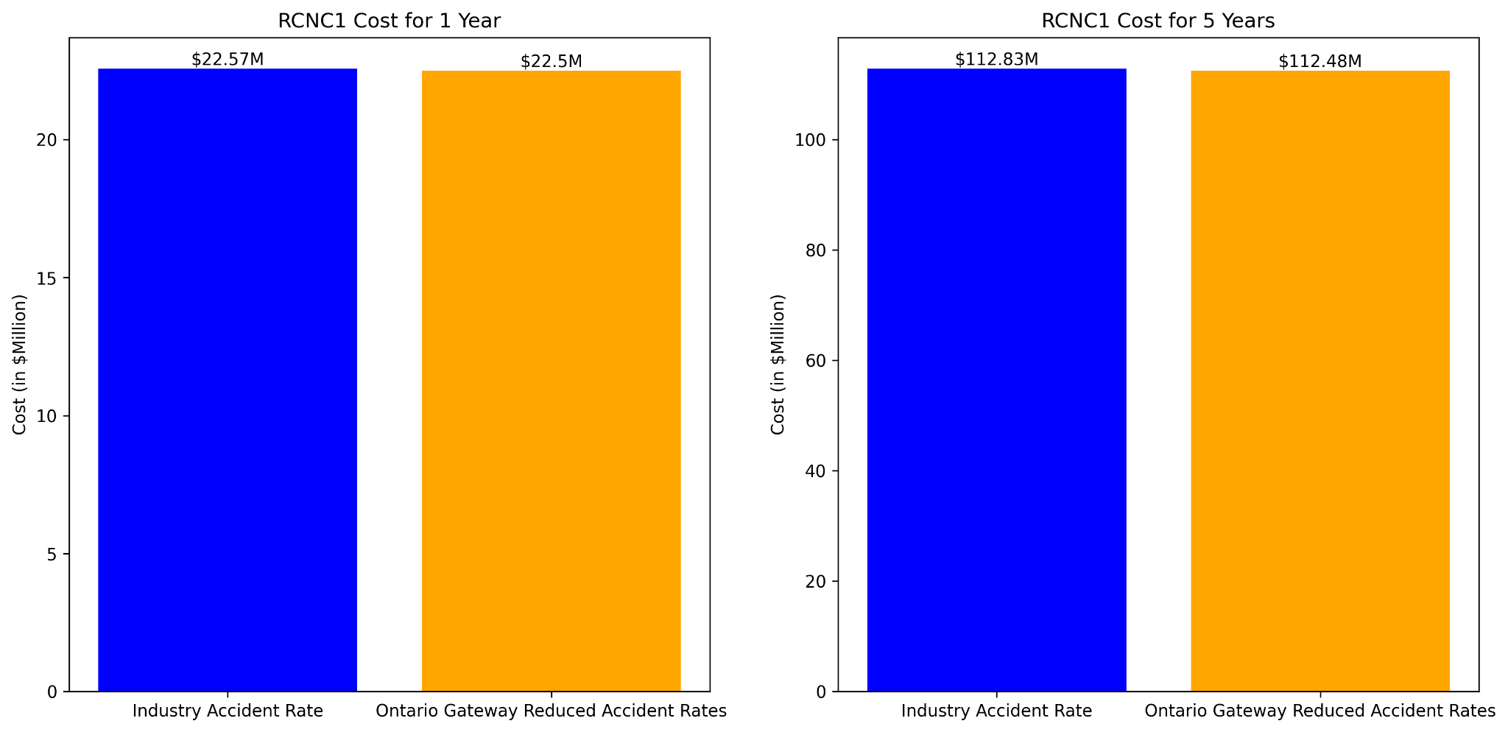
Premium 0.45% of fleet value.
10% deductible on losses.
20% rebate on 5-year cumulative profits
RCNC1 Costs Over 1 and 5 Years
final_cost = total_claim_amt + premium_cost - claim_reimbursement - rebate

Slide 9
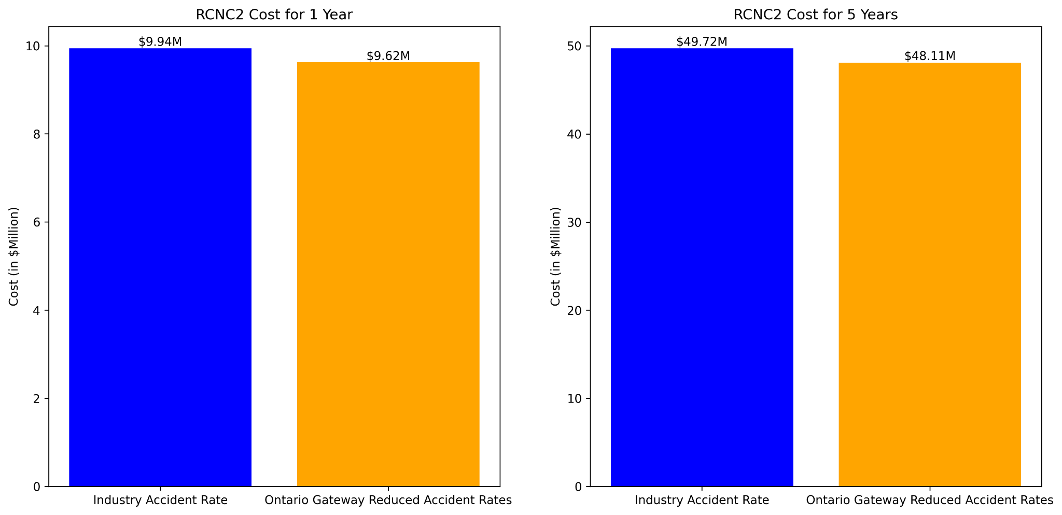
Fixed premium: 0.10% of fleet value.
Variable premium: Lesser of 90% of annual losses or 1% of fleet value
RCNC2 Costs Over 1 and 5 Years

Slide 10
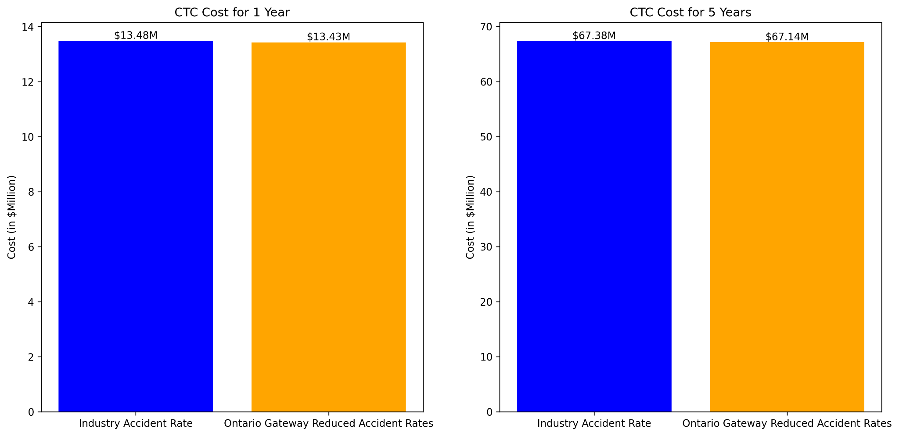
Annual fee: $13 million.
Covers 90% of losses up to $80 million. No coverage beyond.
CTC Costs Over 1 and 5 Years

Slide 11

Premium: 0.165% of fleet value.
Covers losses above $24 million.
3.5% rebate on 5-year cumulative profits.
HIC Costs Over 1 and 5 Years

Slide 12
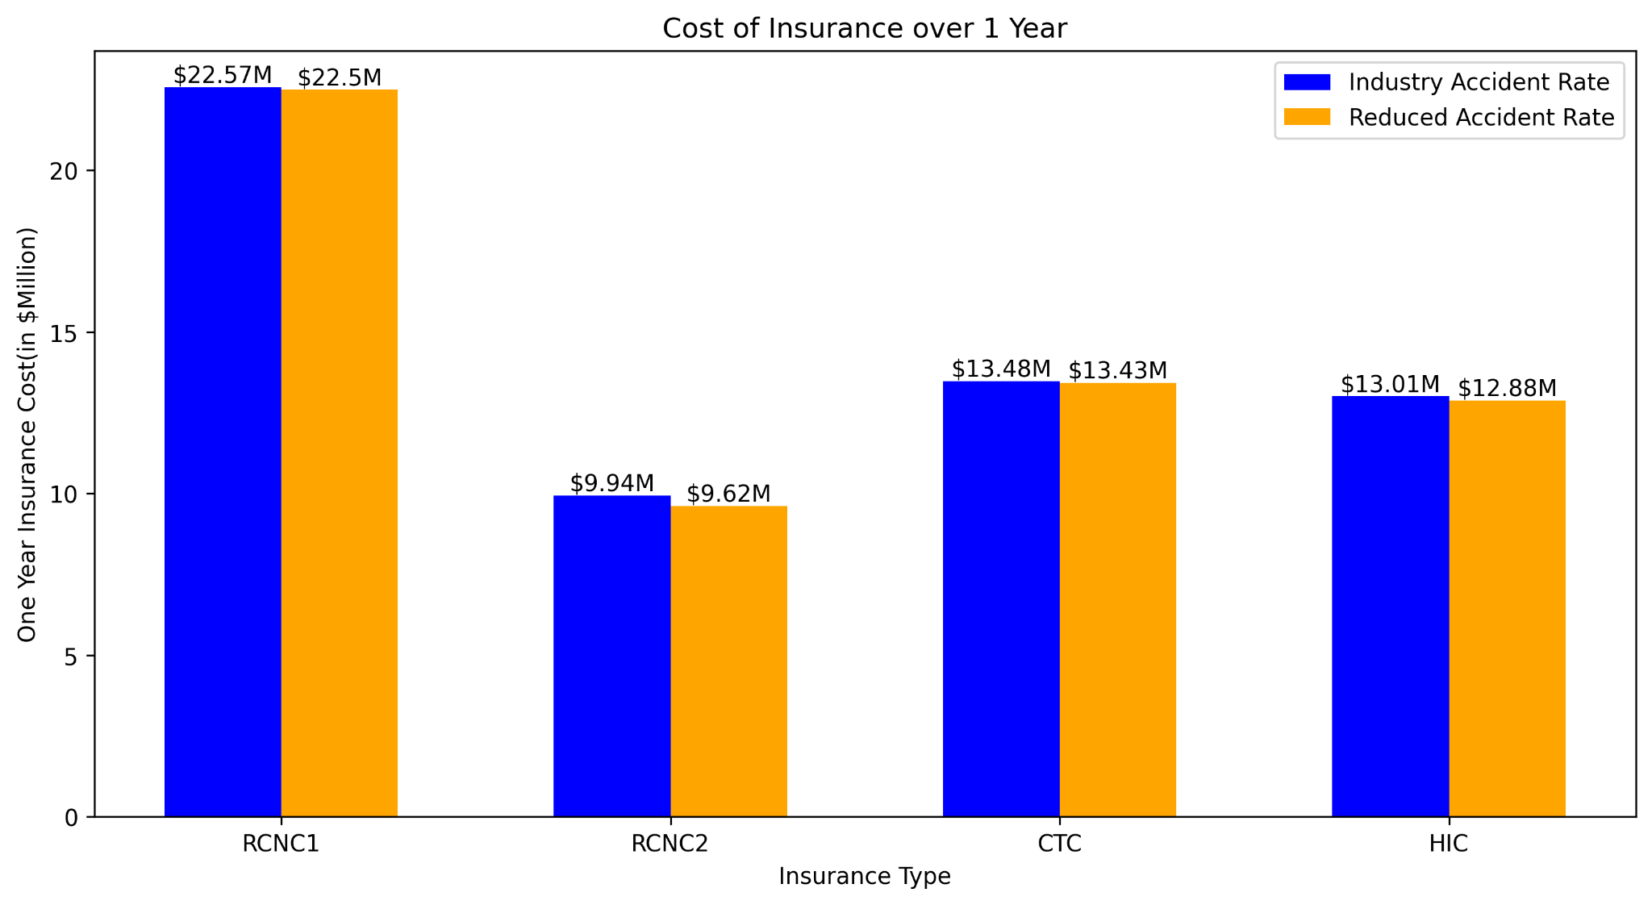
Comparison of Costs Over 1 Year
Notes:
Comparison of overall insurance costs over 1 year across all possible options.
RCNC1 comes out to be the most expensive option at 22M$/year and with RCNC2 being the least expensive option at 9.94M$ a year after HIC.
All Costs slightly reduce when considering Reduced Accident Probability of Ontario Gateway (25% lower than Industry Standard of 1 in 5M)

Slide 13
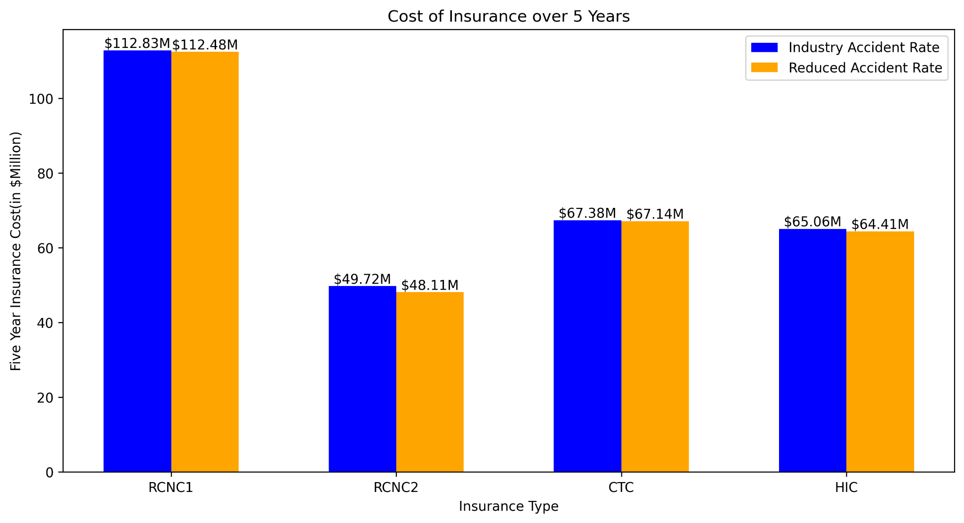
Comparison of Costs Over 5 Years
Notes:
Same trend for 5 year costs as 1 year
RCNC2 being the cheapest out of all at 48$M

Slide 14
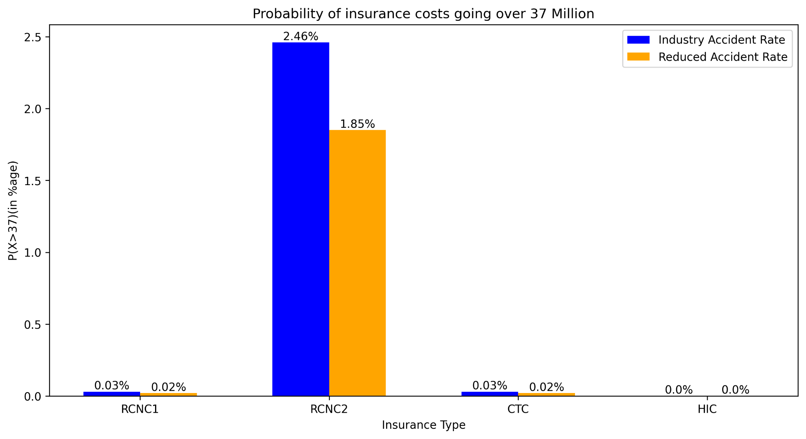
Comparison of Liability Over First Year
Notes:
Comparison of probability of overall costs going over our affordable limit of 37M$ next year.
Only HIC is the one where our risk is minimized to 0%
HIC also happens to be the second cheapest option after RCNC1, difference of 3M$ over the next year and 15M$ over 5 years.

Slide 15
Recommendation Within Liability Limits
Our team's findings Indicate that the only viable option within our conservative liability limitations is to opt for the HIC insurance coverage. While it is not the lowest cost option over 5 years, it is the only option where we can guarantee to not exceed $37 million in liability within the first year of the new policy.

Slide 16
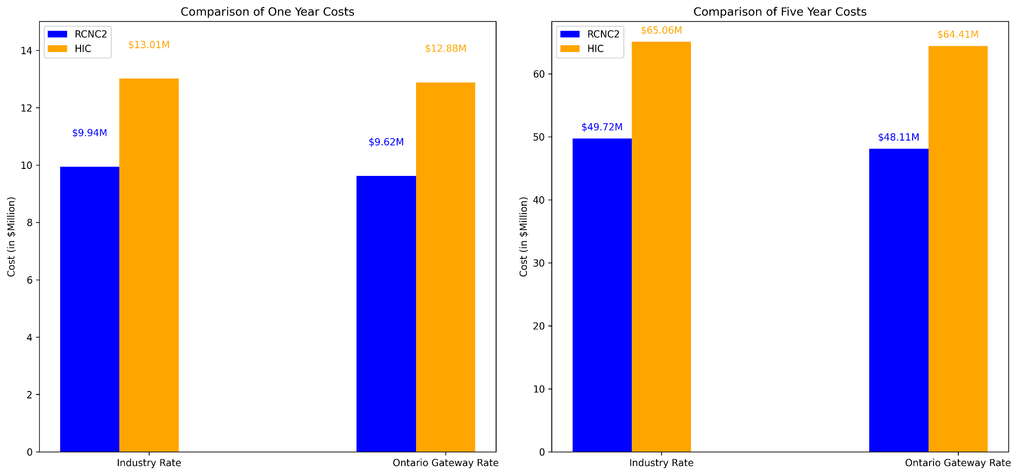
Comparison of RCNC2 and HIC Costs Over 1 and 5 Years

Slide 17
Considerations Regarding Liability Limits
While the HIC insurance plan is the only plan that does meet our conservative risk aversion, it may be worth considering that RCNC2 could potentially be a lower cost alternative. Considerations include:
RCNC2 has the highest possible risk of exceeding our maximum liability threshold within the first year
HIC would cost us between $5 and $6 million more in coverage costs over a 5 year period when considering industry accident rates or Ontario Gateway’s improved rates respectively

